Slide 1



Embedded Systems: Closed loop systems

Slide 2
Today
Introduction into PID control
Practical example
How to tune
Further sources

Slide 3
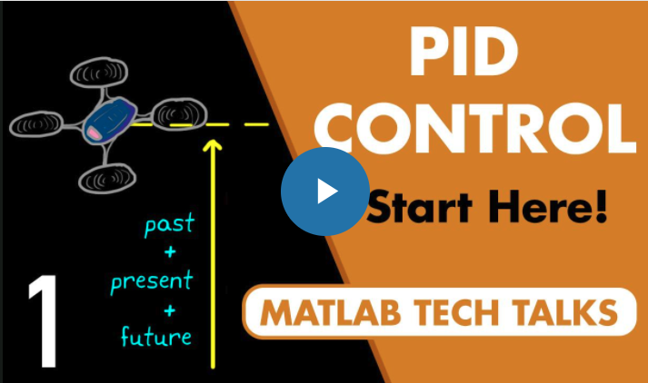



Introduction into PID control
Start at https://nl.mathworks.com/videos/understanding-pid-control-part-1-what-is-pid-control--1527089264373.html
See also https://www.youtube.com/watch?v=4Y7zG48uHRo&ab_channel=AerospaceControlsLab for a nice self driving car demo!
Notes:
Watch all 4 movies!
The first two movies are directly relevant for this course.
The third one is only relevant if you need to react fast (high sampling frequency) and your measuring signal is noisy.
The fourth one is relevant for the non-mathematical part.

Slide 4
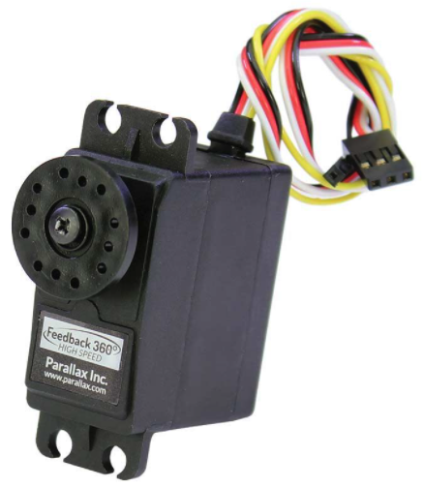
Practical example Position or speed control of the Parallax Feedback 360° High Speed Servo
20 ms
desired position (angle or traveled distance) or desired speed
PWM signal (white wire)
Convert angle, traveled distance or speed to servo control value
+
∑
PID controller
1280 .. 1720 µs
-
P Control:
error = desired position – actual position
PWM = error * Kp Make sure to use the correct signs: When the error increases the PWM signal should make it smaller again!
position feedback signal (yellow wire)
1.1 ms
Convert feedback signal to angle, traveled distance or speed
32 .. 1010 µs
Notes:
Both position and speed control are possible.
Process to control (here the servo) is often called ‘plant’.
Execute the PID control loop at a fixed rate!
See Speaker Notes for details!
Notes:
Notes
The servo feedback signal is a PWM signal with a period of approx. 1.1 ms. The servo control signal is a PWM signal with a period of 20 ms. The servo feedback is updated every 1.1 ms and we want to use this signal to control the servo every 20 ms.
Execute the PID control loop at a fixed rate. This way the behavior is more predictable and the calculations do not have to incorporate variation in control rate.
The servo feedback signal pulse width ranges appr. from 32..1010 for one rotation, so appr. 1000 increments.
The servo feedback signal can be read using a timer in the PWM input mode, see the Timer presentation for details. This will result in a number representing the feedback signal pulse width 32..1010 µs. At maximum speed one rotation takes about 500 ms. For 20 ms this is about 40 increments.
Limit the PWM output signal to the servo to the allowed range!
One can choose to express the position as an angle -180 degrees … +180 degrees.
One can also allow the desired position value to wrap-around so with a value of 100 (cm) the robot will drive 100 cm. Note that the LEGO Mindstorms EV3 robot has such a feature. In this case one has to deal with the wrap-around of the position feedback signal.
For pseudo-code of a PID controller see the introduction_to_pid_controllers_ed2.pdf document in Toolbox->Example programs or http://brettbeauregard.com/blog/2011/04/improving-the-beginners-pid-introduction/.

Slide 5

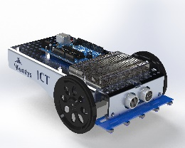
Example project with PID: Platooning Distance control with servo and ultrasonic sensor
Requirements
First car will drive at a random speed.
Following cars will keep a fixed distance to each other using a PID control.
The code for all cars is the same, so each car can take the front position!
Note
Ultrasonic sensor is used to provide the feedback signal i.s.o. the servo position feedback signal.
See the Timers presentation on how to connect an ultrasonic sensor to an STM32 NUCLEO board.
Question
How to handle curves?

Slide 6
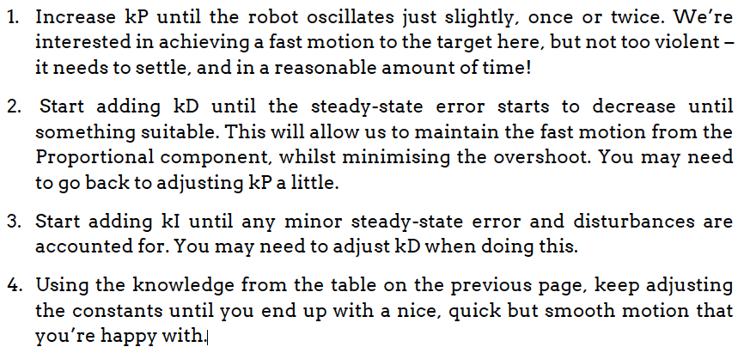
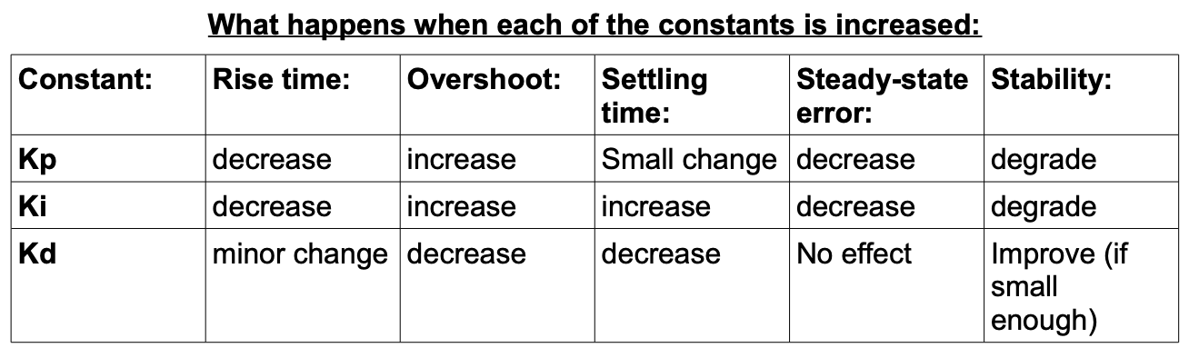
Tuning the PID parameters Heuristic approach: closed loop manual tuning using a simple recipe
Notes:
Simplest method.
Model of the plant does not have to be known.
You will get a good intuition of how PID works.
Can be difficult to get good results.
From http://georgegillard.com/programming-guides/introduction_to_pid_controllers_ed2-pdf?format=raw

Slide 7
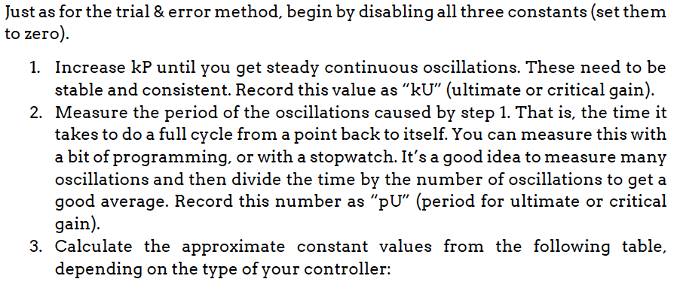
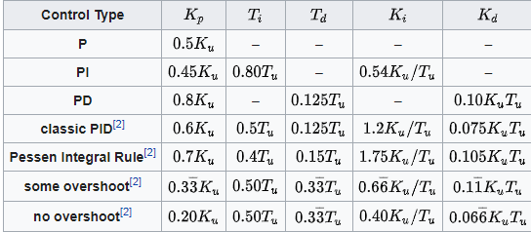
Tuning the PID parameters Heuristic approach: Ziegler-Nichols closed loop method
Notes:
Closed loop behavior of the plant has to be measured and serves as the basis for tuning.
Less ‘trial and error’ than previous method.
Model of the plant does not have to be known.
Good result is not guaranteed.
From: http://georgegillard.com/programming-guides/introduction_to_pid_controllers_ed2-pdf?format=raw
https://en.wikipedia.org/wiki/Ziegler%E2%80%93Nichols_method
Notes:
The result is very dependent on the process / plant and finding proper settings might require some experimenting.

Slide 8
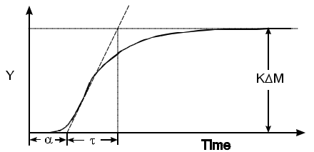
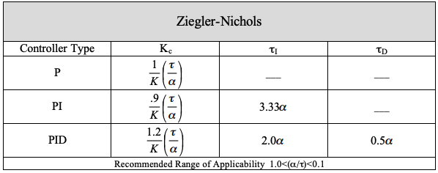
Tuning the PID parameters Heuristic approach: Ziegler-Nichols open loop method
Notes:
Open loop step response of the plant has to be measured and serves as the basis for tuning.
Model of the plant does not have to be known.
Good result is not guaranteed.
From http://educypedia.karadimov.info/library/pidtune2.pdf
Notes:
Works only for 1st order with delays and 2nd order or greater.
These tuning rules do not work for integrating processes ( e.g. position control of a servo )

Slide 9
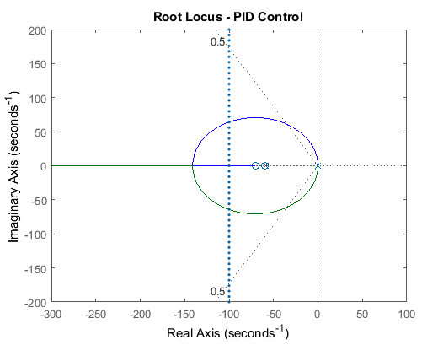
Tuning the PID parameters Mathematical approach: Root Locus method
Notes:
Best method when you have the mathematical model of the plant.
Requires mathematical knowledge not covered in this semester.
We will not do this in this course!
From https://www.youtube.com/watch?v=n829SwSUZ_c

Slide 10
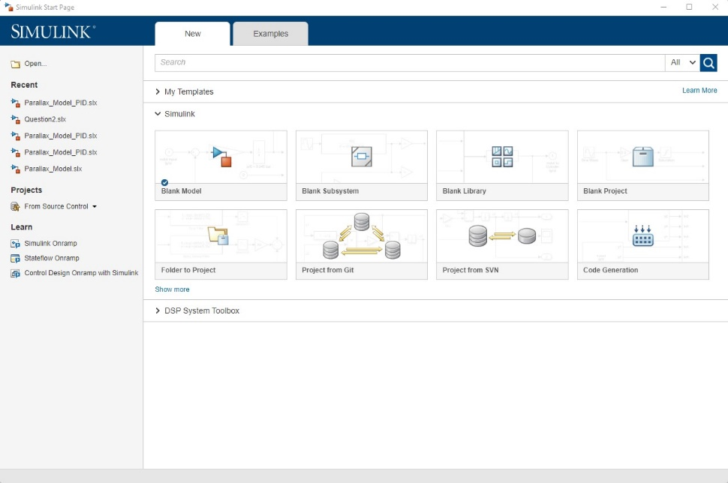
Use Simulink for simulating the feedback control loop
Advantages simulation:
Start with design before writing code
You can quickly tune the P, I and D parameters and see the behavior. There is also an auto tune!
Afterwards you can check the implementation with the simulation.
Notes:
Installing MATLAB / Simulink:
Goto https://nl.mathworks.com/academia/tah-portal/fontys-hogescholen-31089256.html and create an account using your Fontys email address.
Download and install MATLAB.
Install the following add-ons:
Simulink.
Signal Processing Toolbox.
Simulink Control Design.
Control System Toolbox.

Slide 11
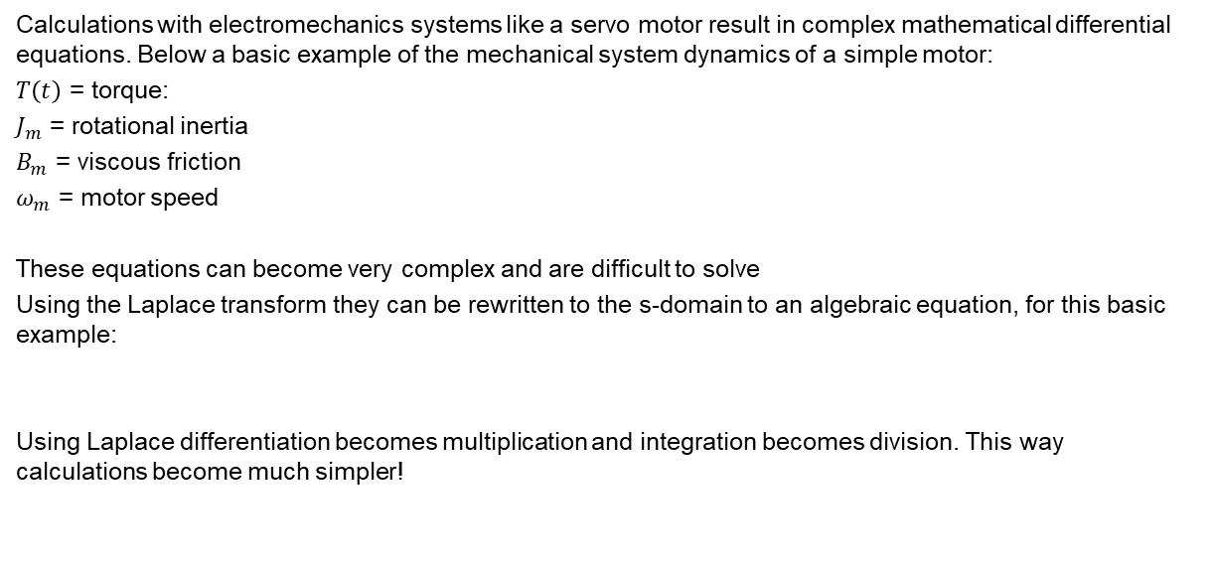

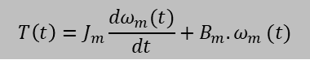
Intermezzo: Laplace and Z transform
Calculations with electromechanics systems like a servo motor result in complex mathematical differential equations. Below a basic example of the mechanical system dynamics of a simple motor:
$T\left(t\right)$ = torque:
$J_{m}$ = rotational inertia
$B_{m}$ = viscous friction
$ω_{m}$ = motor speed
These equations can become very complex and are difficult to solve
Using the Laplace transform they can be rewritten to the s-domain to an algebraic equation, for this basic example:
Using Laplace differentiation becomes multiplication and integration becomes division. This way calculations become much simpler!
$$T\left(t\right)=J_{m}\frac{{dω}_{m}(t)}{dt}+B_{m}{.ω}_{m}(t)$$
$$T\left(s\right)={(J}_{m}.s+B_{m}{).Ω}_{m}(s)$$

Slide 12
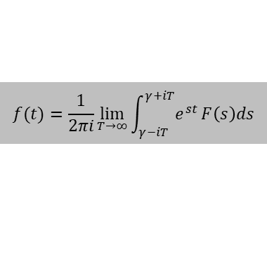
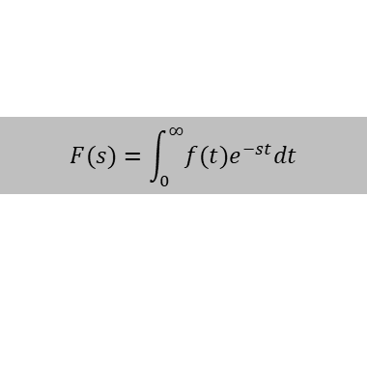
Intermezzo: Laplace and Z transform
Laplace transform formula going from time domain to s-domain:
Inverse Laplace transform formula, going from s-domain to time domain:
z-domain:
As we are dealing with a processing loop which only is executed x times per second, we have to do the actual simulation in Simulink taking the sampling time into consideration. Therefore we have to set the PID controller to ‘discrete-time’ which is called the z-domain. Therefore the PID function is written as PID(z).
$$F(s)=\int_{0}^{∞}{f(t)e^{−st}dt}$$
$$f(t)=\frac{1}{2πi}\lim_{T→∞}\int_{γ−iT}^{γ+iT}{e^{st}}{F\left(s\right)ds}$$
Note:
The mathematics is not part of the learning outcome, but for a good introduction in Laplace transfoms, see https://www.youtube.com/watch?v=8oE1shAX96U&ab_channel=MathandScience

Slide 13
From simulation to implementation steps to follow
Determine the s-domain transfer function of the servo motor using the step response. This will be the servo model which Simulink can use to do the simulations. The step response function of the Parallax Feedback 360° High-Speed Servo can be found in ‘ParallaxStepResponse.xlsx’ in the Toolbox section of the course.
Implement the feedback control loop in Simulink, see following slides.
Start by using a simple P controller (I and D zero) and experimentally determine the value for P which gives a reasonable result.
Next, try to improve as follows:
In the PID Controller window, select the desired controller (P, PD or PID) and then use the ‘Tune’ button. Use the ‘Slower – Faster’ and ‘Aggressive – Robust’ sliders at the top of the PID Tuner window to finetune and get the response you would like to have.
Optional: Using the Ziegler-Nichols heuristic closed loop method.
Note: when doing position control, the servo itself already contains an integrator (1/s). Doing only P or PD control might give the best results.
Implement the Feedback Control loop in code, using the P, I and D values found in Simulink.
Note that you will have to incorporate the servo gain and the Simulink sample time also in code, see next slide.
And last but not least: compare the actual results with the simulated results!

Slide 14
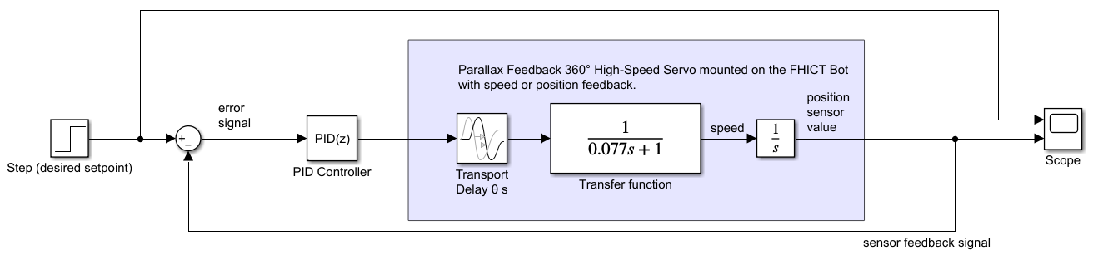
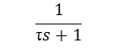
Feedback control loop in Simulink
$$\frac{1}{\text{τ}s+1}$$
See Speaker Notes for details!
Notes:
General:
The Parallax Feedback 360° High-Speed Servo mounted on the FHICT bot is modeled as follows:
The FHICT bot is put on the floor and a step input is applied to the 2 Parallax motors.
The speed is measured, resulting in a step response
From the step response the transport delay and transfer function are determined.
The integrator 1/s is needed when position control is applied. It converts the speed to a position signal.
Dealing with servo dead zone:
In the Parallax Feedback 360° High-Speed Servo datasheet it can be seen that the PWM control signal has purposely a 'dead zone’ of +/- 20 μs around the PWM stop value 1500 μs. For PID control that is undesired, so for better performance remap the PWM control value to skip the dead zone.
Simulink settings:
In the Simulink PID block, select ‘Discrete-time’ and fill in an appropriate ‘Sample time’. This is the time between two executions of the feedback loop and has to correspond to your actual implementation in code! Take a value that makes sense with respect to what you need to control. For example, for a servo you can take 20 ms (see data sheet), but for a heating system the sample time can be much longer.
Scaling of signals:
In this Simulink model it is assumed that the servo model has a gain of 1.
For speed control (no integrator 1/s) this means:
When the servo speed is measured in cm/s, also the desired setpoint has to be in cm/s. With a servo input of 10 the servo will travel at a speed of 10 cm/s. Note that the servo speed is dependent of the wheel circumference.
For position control this means:
When the servo position is measured in cm, also the desired setpoint has to be in cm. With a servo input of 10 the servo will travel at a speed of 10 cm/s towards the desired position. Note that when the measured position equals the desired position, the error signal will be zero and the servo input (= PID output) will also go towards zero and so will the servo speed.
In the actual implementation the gain of the servo will not be 1 and this has to be corrected for in the code.
Also the feedback loop control rate (e.g. 20 ms) has to be taken into account.
Example determining the servo gain in your setup
For speed control (no integrator 1/s): Suppose a PID output going from 0 to 100 units results in the servo speed going from zero to maximum speed, and at maximum speed the measured speed is 40 units, then the servo gain is 40 / 100 = 0.4.
For position control: Suppose a PID output going from 0 to 100 units results in the servo speed going from zero to maximum speed, and at maximum speed the measured position increases 2000 units every second, then the servo gain is 2000 / 100 = 20.
Note that ‘unit’ in this case can be any unit (like cm, m/s, cm/20ms, degrees etc.) as long as the unit used for the sensor feedback signal is the same as the unit used for setting the setpoint. In other words, for the feedback loop it is irrelevant whether it is controlling speed, position, temperature etc.
Example scaling of the P, I and D factor
Suppose the Simulink sample time is 20 ms (= 0.02 s) and this is also the rate in which the Feedback loop is executed in code.
Also suppose that the actual servo gain is 10.
Then:
The P factor found in Simulink must be divided by 10.
The I factor found in Simulink factor has to multiplied by 0.02 and divided by 10.
The D factor found in Simulink has to be divided by 0.02 and divided by 10.
In the code example at http://brettbeauregard.com/blog/2011/04/improving-the-beginners-pid-introduction/ this above is implemented by the factor ‘timeChange’.

Slide 15
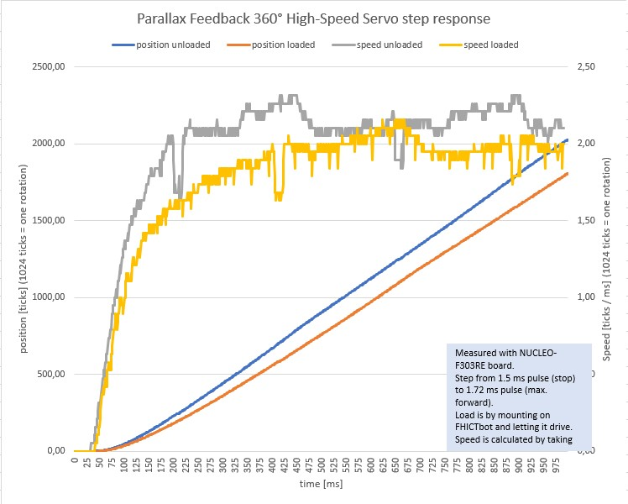
Step response of the Parallax Feedback 360° High-Speed Servo
The step response tells us something about the characteristics of the servo motor. We need this information to simulate the servo in Simulink.
Notes:
The step response (speed) of the Parallax Feedback 360° High-Speed Servo is measured for two situations:
Unloaded; no load attached.
Loaded; two servo’s are mounted on the FHICT bot which is put on the ground.
From the step response the transport delay θ and transfer function are determined.\
The Excel sheet containing the measurent data can be found in the FCS part of the Canvas course.

Slide 16
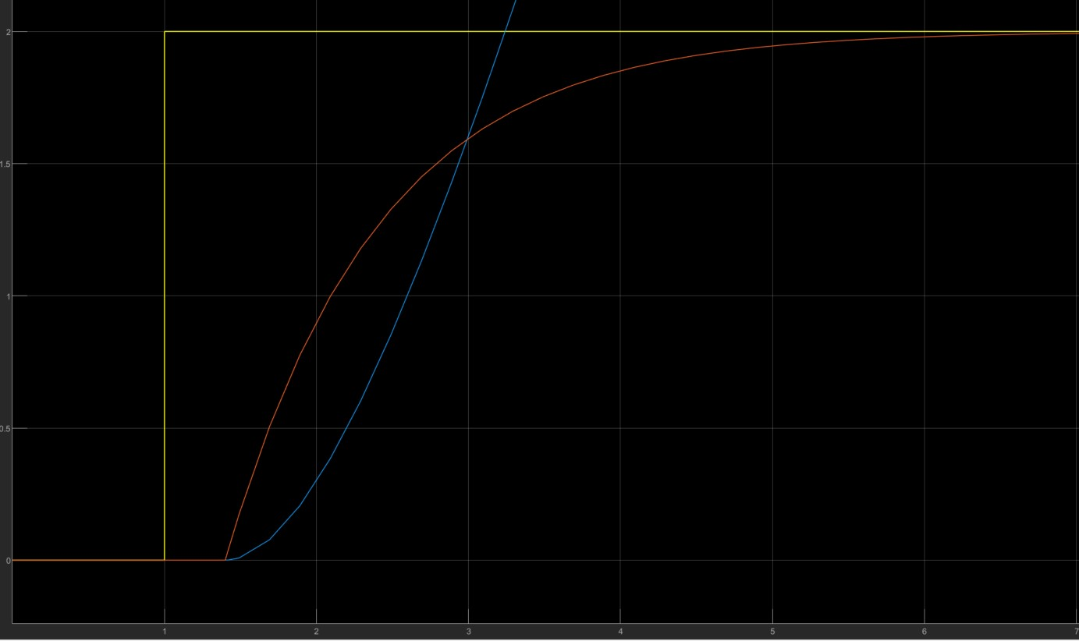

Step response to transfer function The transfer function can be used in Simulink
step input
position
speed
0.63 * A
$$\frac{1}{\text{τ}s+1}$$
Transfer function:
A
Transport delay: θ
θ
τ

Slide 17
Further sources
https://www.youtube.com/watch?v=n829SwSUZ_c
https://smithcsrobot.weebly.com/uploads/6/0/9/5/60954939/pid_control_document.pdf
http://educypedia.karadimov.info/library/pidtune2.pdf
http://georgegillard.com/programming-guides/introduction_to_pid_controllers_ed2-pdf?format=raw
http://brettbeauregard.com/blog/2011/04/improving-the-beginners-pid-introduction/

